Slide 1
Tension and Friction
Dynamics & Newton’s Laws of Motion

Slide 2
Agenda
Content and Language Objectives
Tension, Pulleys
Misconception Alert
Greek Letter Alert: μ
Friction, Static & Kinetic
Review Objectives
Questions
Homework

Slide 3
Content Objectives
Calculate tension in a flexible cord
Account for effect of pulleys on tension
Differentiate between static and kinetic friction
Calculate friction given the coefficient of friction and mass
Apply the effects of static and kinetic friction to determine net force and resulting acceleration

Slide 4
Language Objectives
Utilize Greek lower-case mu with appropriate subscript for coefficient of static or kinetic friction (μ_{s}, μ_{k})
Correctly use pulley and block when describing systems under tension
Correctly use angle of repose when describing objects on inclined planes
Utilize the Greek upper-case sigma (Σ) for “sum of…” or net force
Construct and interpret free body diagrams to determine pairs of forces acting on an object

Slide 5
Tension
Under tension: When a flexible cord is pulled taught
When cord mass negligible, tension transmitted undiminished to each piece of cord through to the end
Forces pulling at both ends must add to zero: F_{T} and –F_{T}

Slide 6
Misconception Alert!
“Tension on the cable is 10 N…”
Tension is not shared between the two endpoints (not 5 N each), both ends see 10 N of force
F_{T1}
F_{T2}
m₁
m₂
|F_{T1}| = |F_{T2}| = 10 N

Slide 7
Misconception Alert!
“…pulls on m₁ with a force of 10 N…”
Tension in the cable is 10 N total, and it pulls on m₂ with 10 N of force. Tension is not 20 N.
F_{T1}
F_{T2}
m₁
m₂
|F_{T1}| = |F_{T2}| = 10 N

Slide 8
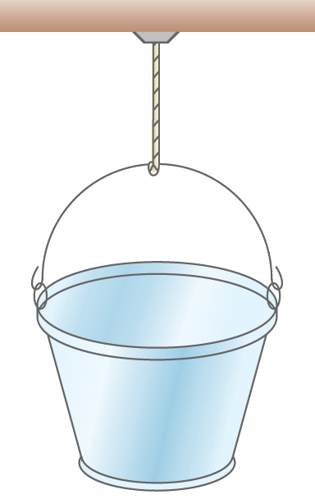
Tension
Free-body diagram on the mounting point on bottom of shelf (click)
Is the mounting point accelerating?
Free-body diagram on the pail
Is the pail accelerating?
F_{TShelf support} = –F_{T}

Slide 9
Tension
Free-body diagram on the mounting point on bottom of shelf
Is the mounting point accelerating?
Free-body diagram on the pail
Is the pail accelerating?
F_{TShelf support} = –F_{T}
F_{T} = F_{g}

Slide 10
Tension
Free-body diagram on the mounting point on bottom of shelf
Is the mounting point accelerating?
Free-body diagram on the pail
Is the pail accelerating? (click)
F_{TShelf support} = –F_{T}
F_{T} = F_{g}
F_{T} = –F_{g}

Slide 11
Tension
Free-body diagram on the mounting point on bottom of shelf
Is the mounting point accelerating?
Free-body diagram on the pail
Is the pail accelerating?
F_{TShelf support} = –F_{T}
F_{T} = F_{g}
F_{T} = –F_{g}
F_{g} = m_{pail}g
“You can’t push a rope.”

Slide 12
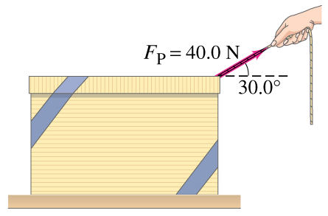
Warm-up Example
You pull a 10.0 kg box across the “smooth surface” (code for frictionless) of a table. You pull with a force of 40.0 N at 30.0° up from the horizontal.
Calculate the normal force the table applies to the box.
Calculate the acceleration of the box.

Slide 13
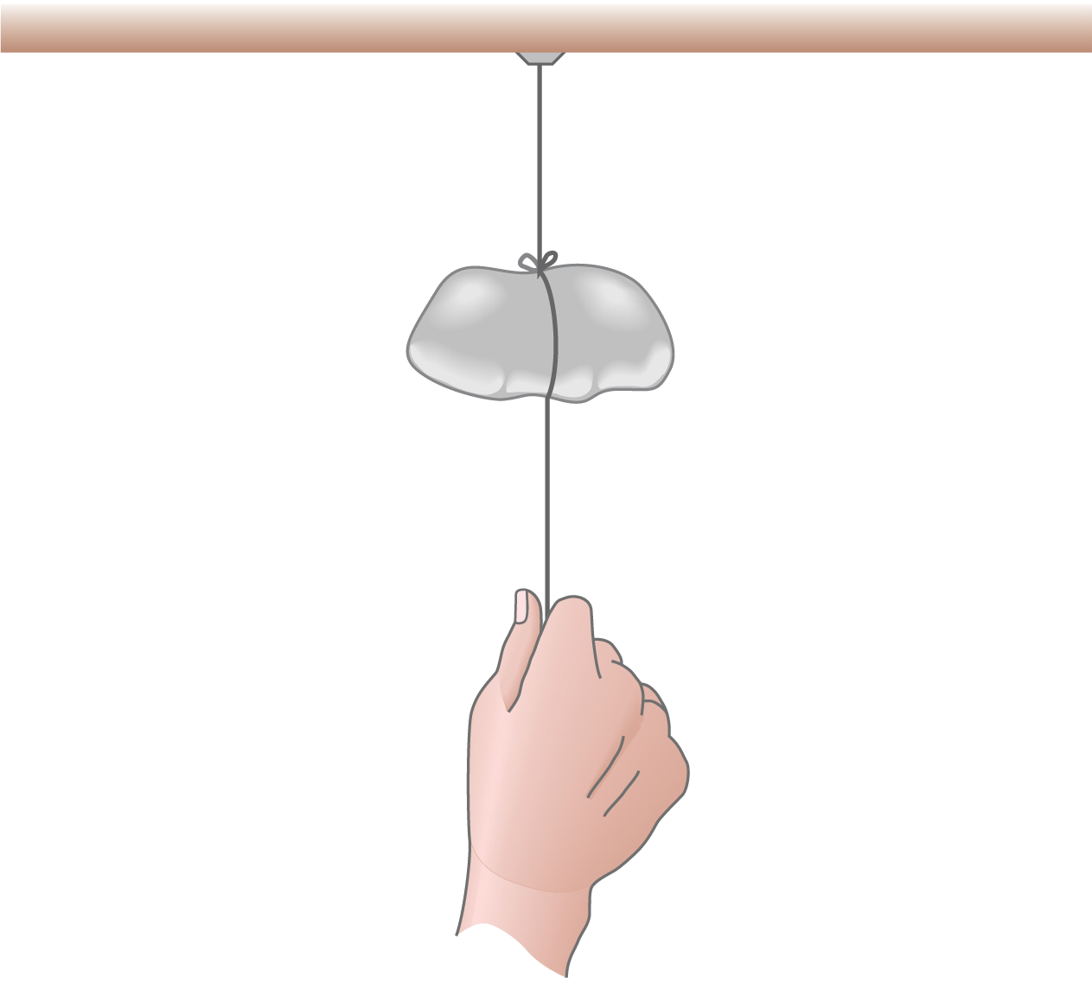
Tension Example
A 227 g rock is suspended from a string secured to the bottom of a shelf.
A student then pulls on a string dangling from the rock with a force of 5 N.
What is the tension on the string attached to the shelf?
Hint: This is the force pulling up on the rock

Slide 14
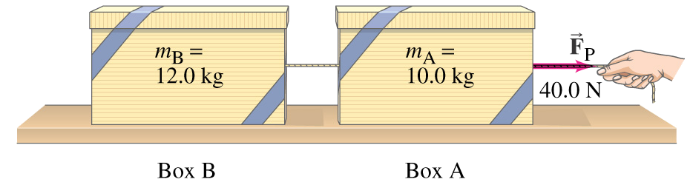
Tension Example
Two boxes, A and B, are connected by a lightweight cord and resting on a smooth surface. The boxes have masses of 10.0 kg and 12.0 kg, respectively. A person pulls on the cord with a force of 40.0 N parallel to the surface.
Calculate the acceleration of both boxes.
Calculate the tension in the cord connecting the two boxes.

Slide 15
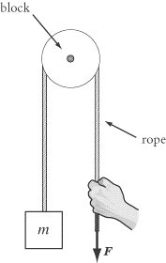
Pulleys
Changes direction of force
Ideal: no losses
Pulley – Wheel or axle supporting movement of a cable along its circumference
One of 6 classical simple machines
Block – Mounting for one or more pulleys
Free body diagrams to analyze

Slide 16
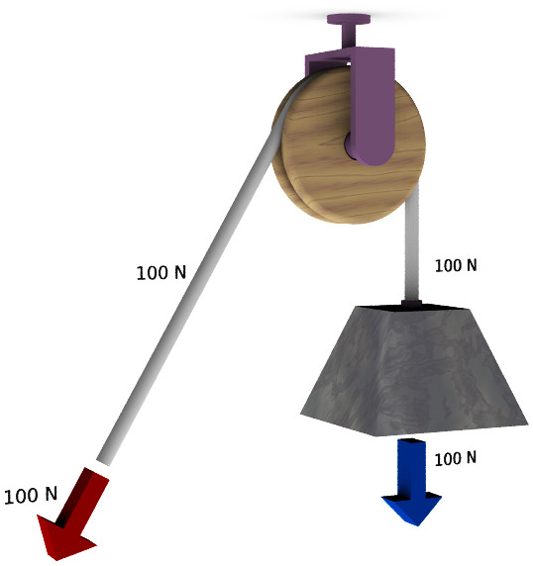
Pulleys
Simple pulley

Slide 17
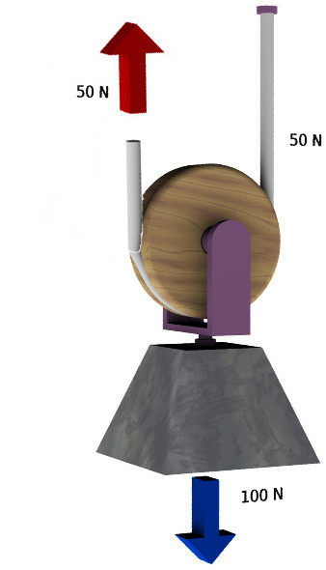
Pulleys
Mechanical advantage 2×

Slide 18
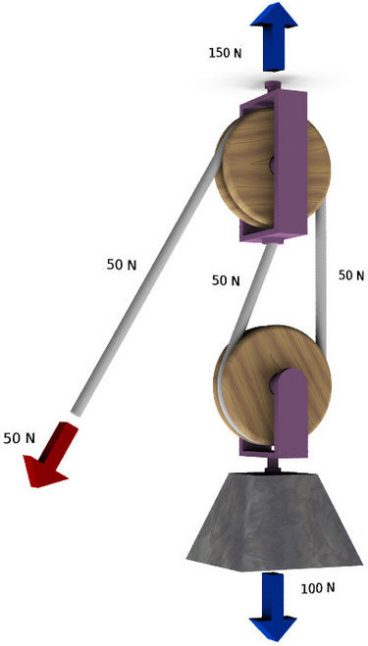
Pulleys
Mechanical advantage 2×
Note the tension on the mounting point F_{t} = 1.5  F_{g}
Redirects applied force

Slide 19
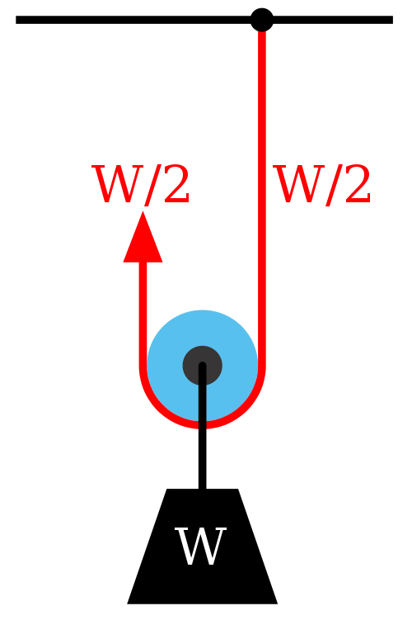
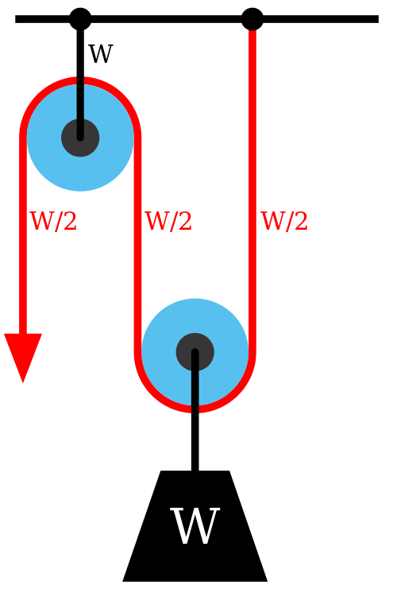
Pulleys
Mechanical advantage 2×

Slide 20
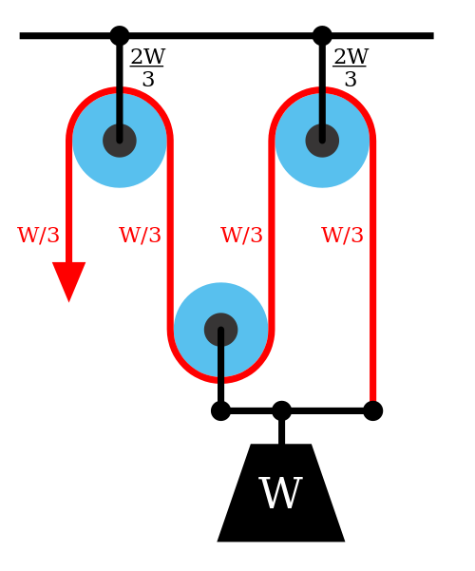
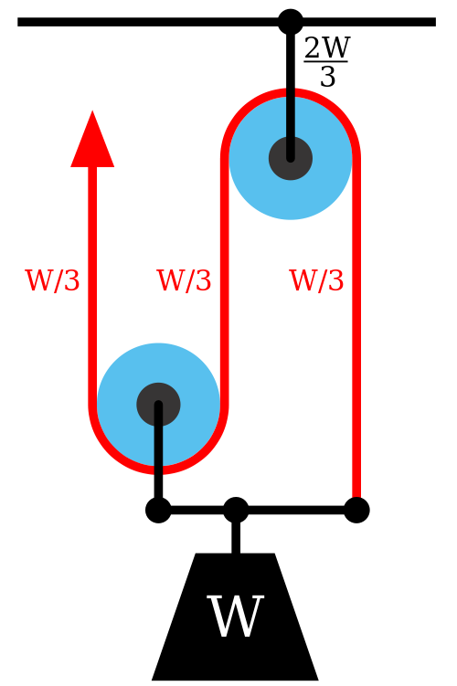
Pulleys
Mechanical advantage 3×

Slide 21
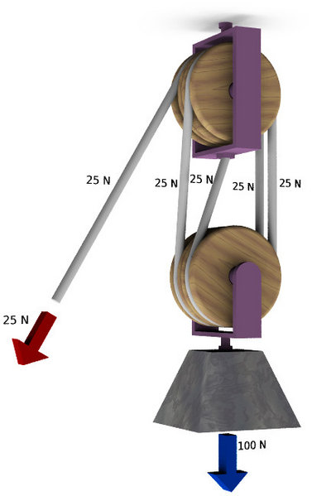
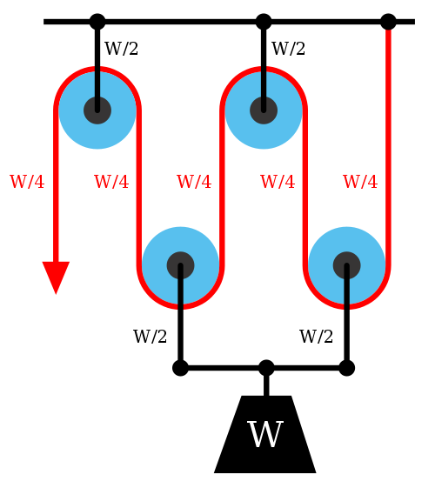
Pulleys
Mechanical advantage 4×

Slide 22
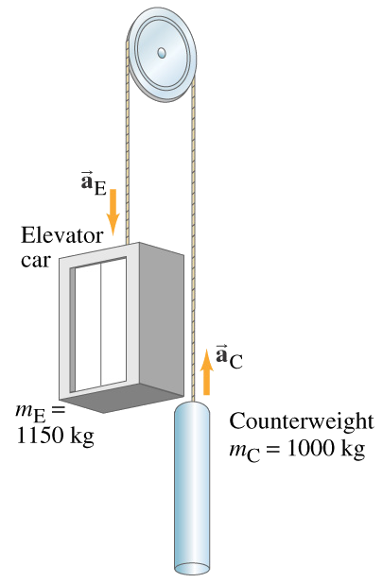
Tension Example
Elevator and counterweight suspended over an “ideal pulley” (no mass, frictionless) by a flexible, mass-less cable. Mass of empty elevator is 850 kg.
Calculate acceleration of the system when elevator is empty.
Calculate acceleration of the system when elevator has passengers for a total mass of 1150 kg.

Slide 23
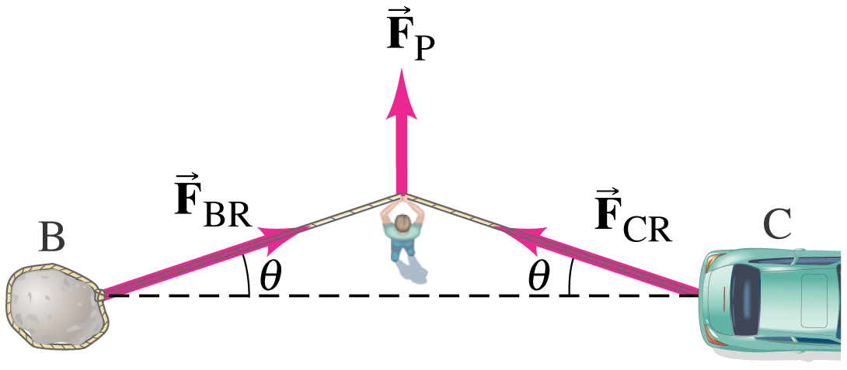
Example
Finding her car stuck in the mud, a bright graduate of a good physics course ties a strong (massless) rope to the back bumper of the car and the other end to a boulder. She pushes at the midpoint of the rope with her maximum effort, 300 N. The car just begins to budge with the rope at an angle of 5.00°
With what force is the rope pulling on the car?
CLICK

Slide 24
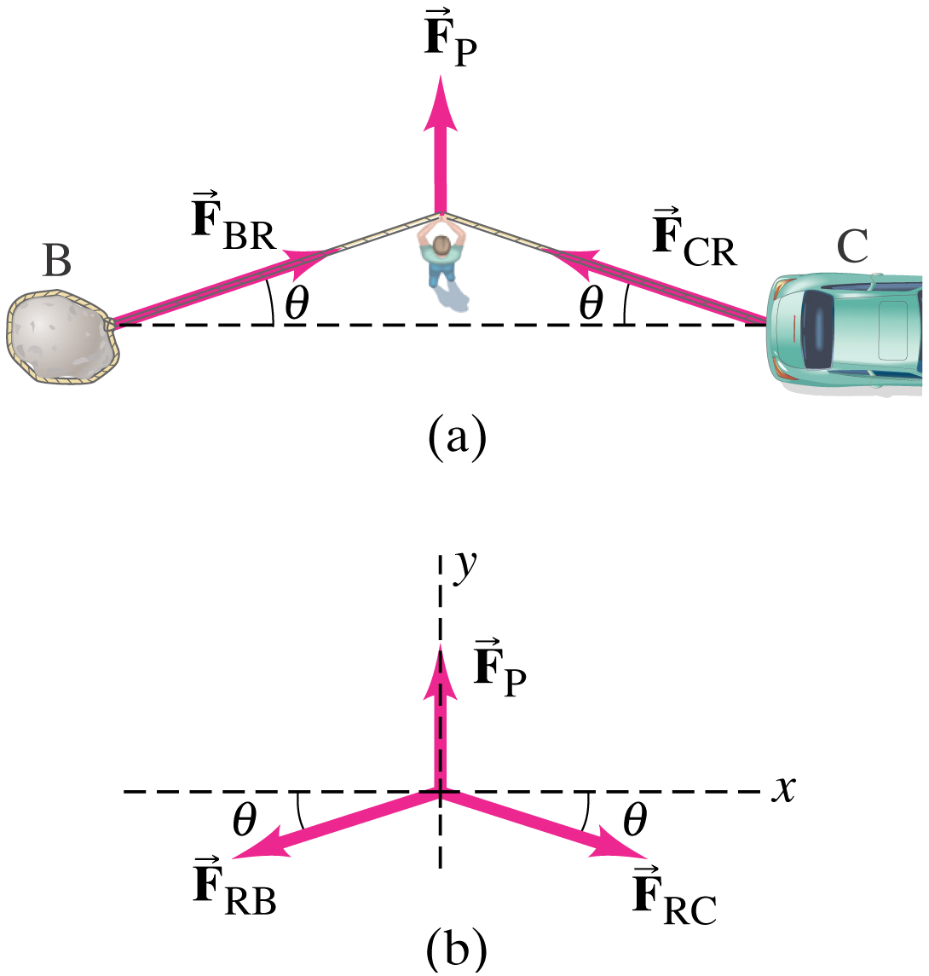
Example
“The car just begins to budge…”
What is F_{NET}?
F | x- comp | y-comp
F_{P}
F_{RB}
F_{RC}
Σ

Slide 25

Greek Letter Alert
Lower-case mu (m-you)
Greek lower-case m
SI prefix for “micro” μm for micrometer
Coefficient of static or kinetic friction (μ_{s}, μ_{k})

Slide 26
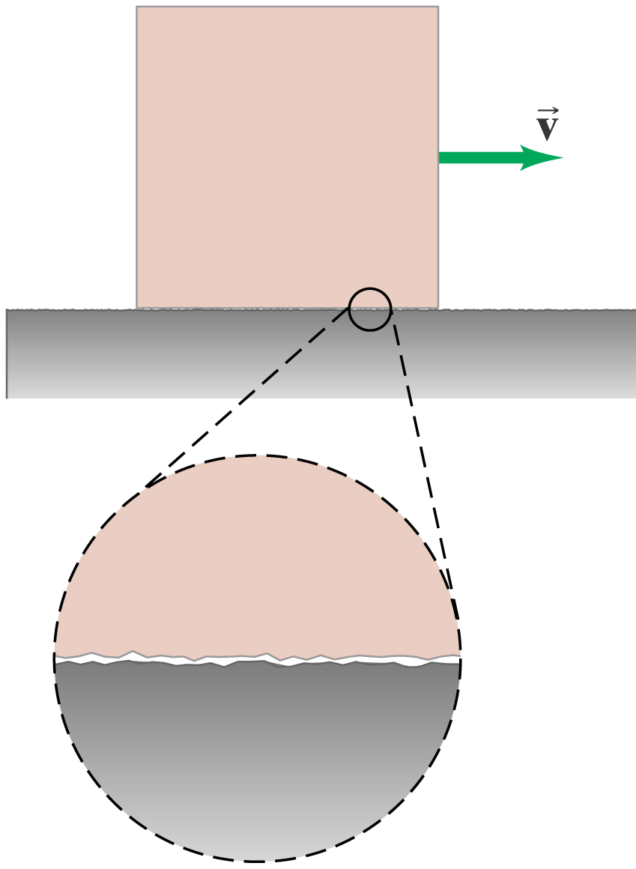
Friction
Force resisting relative motion
Smoothest surfaces are rough on microscopic scale
Poorly understood interactions between molecules
Opposes applied force or motion

Slide 27
Static Friction
Magnitude depends on applied force
Opposes applied force up to a certain point
Motion begins once F_{s-max} exceeded
Dimensionless coefficient of static friction, μ_{s}
Function of normal force, F_{n}
Notes:
When side force, F, is applied, f_{s} increases with the applied force until the object slips / begins to move.
When the object is on the verge of moving, f_{s} is at a maximum.
Once the object is moving, force from friction decreases → kinetic friction, f_{k}

Slide 28

Static Friction Example
A 8.75 kg recycling bin (full) initially at rest on a horizontal floor requires a 25.0 N horizontal force to set it in motion.
Find the coefficient of static friction between the crate and the floor.

Slide 29
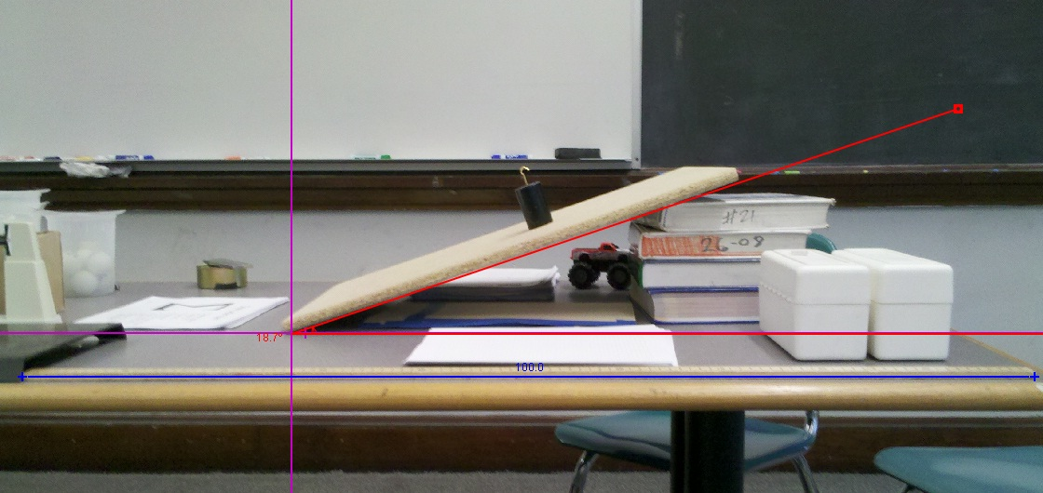
Static Friction Example
The 1.00 kg mass is on a ramp inclined 18.7° from the horizontal.
What is the coefficient of static friction between the mass and the ramp?

Slide 30
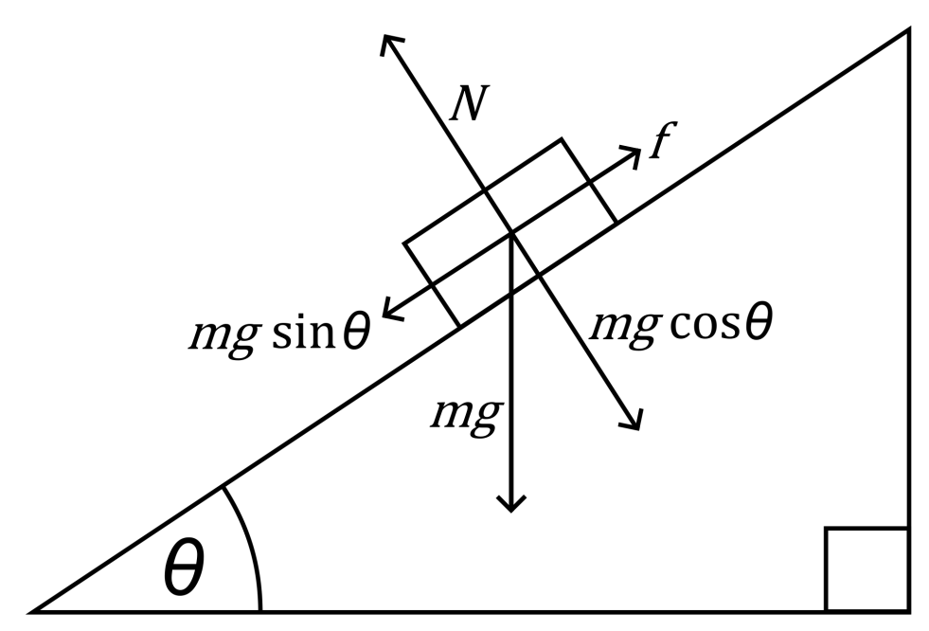
Angle of Repose
The maximum angle an object rest on an inclined plane without sliding down
F_{SF} = μ_{s} F_{N} = mg sin θ μ_{s} mg cos θ = mg sin θ
θ_{repose} = tan^{–1}μ_{s}

Slide 31
Kinetic Friction
Constant motion when applied force equals kinetic friction, F_{k}
Opposes velocity, kinetic energy converted to heat
Acceleration when applied motion exceeds kinetic friction
Dimensionless coefficient of static friction, μ_{k}
Function of normal force, F_{n}

Slide 32
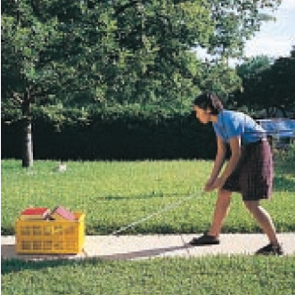
Kinetic Friction Example
A student moves a box of books by attaching a rope to the box and pulling with a force of 90.0 N at an angle of 30.0°. The box of books has a mass of 20.0 kg, and the coefficient of kinetic friction between the bottom of the box and the sidewalk is 0.50.
Find the acceleration of the box.

Slide 33
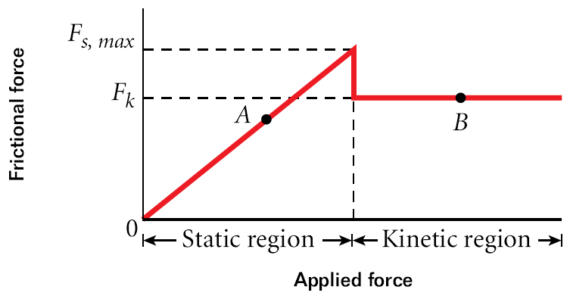
Combined Friction Effect
Notes:
No motion in the static region until F_{applied} ≥ F_{s}. Object then starts to accelerate. Object continues to accelerate because F_{applied} exceeds F_{k}.

Slide 34
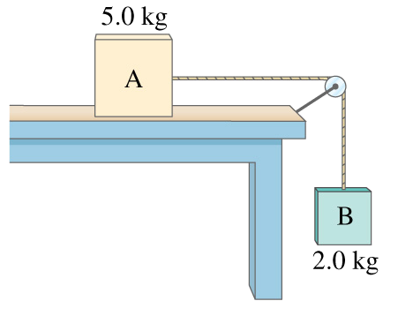
Example
Two boxes are connected by a (lightweight) cord running over a(n ideal) pulley. The coefficient of kinetic friction between Box A and the table is 0.20.
Find the acceleration of the system.
Hint: “Unfold” the system then FBDs on both boxes.
Note the acceleration for both boxes are the same.

Slide 35
Zdeno Chára
VIDEO
Boston Bruins captain, #33
6’ 9” (206 cm), tallest in NHL
Fastest slapshot, 108.8 mph (175.1 km/hr), 2012 NHL All Star Game

Slide 36
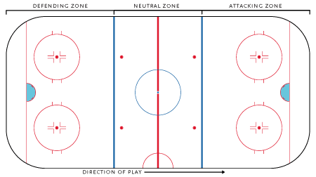
Practice
While killing a Montreal Candiens power play, Chára shoots the puck from the Bruins’ goal line to the Habs’ goal line 54.25 m away, with his world-record slapshot. The velocity of the puck at the Habs’ goal line is 131.3 km/hr.
Find μ_{k}. Puck mass is 158 g, but you shouldn’t need that.
CLICK

Slide 37
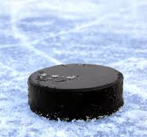
Practice
v
F_{N} = –Fg = +mg
F_{kf} = –μ_{k}F_{N}
F_{g} = –mg

Slide 38
Practice
A 10.0 kg box is pulled up a 45.0° ramp at a constant velocity by a force of 90.0 N acting parallel to the ramp.
Find the coefficient of kinetic friction.
CLICK

Slide 39
Practice
A 10.0 kg box is pulled up a 45.0° ramp at a constant velocity by a force of 90.0 N acting parallel to the ramp.
Find the coefficient of kinetic friction.
F_{A}
F_{N}
F_{kf}
θ
F_{g} = mg
CLICK

Slide 40
Practice
A 10.0 kg box is pulled up a 45.0° ramp at a constant velocity by a force of 90.0 N acting parallel to the ramp.
Find the coefficient of kinetic friction.
F_{N}
F_{kf}
F_{A}
θ
F_{g} = mg
CLICK

Slide 41
Practice
A 10.0 kg box is pulled up a 45.0° ramp at a constant velocity by a force of 90.0 N acting parallel to the ramp.
Find the coefficient of kinetic friction.
SAME!
F_{N}
F_{kf}
F_{A}
θ
F_{g} = mg

Slide 42
Practice
A 10.0 kg block is placed on top of an inclined plane 10.0 m long. The coefficient of static friction is 0.400 and the coefficient of kinetic friction is 0.200. The inclined plane is 30.0° from the horizontal.
What is the acceleration of the block?
When will it hit the ground?
What is its impact velocity?
What is the angle of repose?

Slide 43
Content Objectives
Calculate tension in a flexible cord
Account for effect of pulleys on tension
Differentiate between static and kinetic friction
Calculate friction given the coefficient of friction and mass
Apply the effects of static and kinetic friction to determine net force and resulting acceleration

Slide 44
Language Objectives
Utilize Greek lower-case mu with appropriate subscript for coefficient of static or kinetic friction (μ_{s}, μ_{k})
Correctly use pulley and block when describing systems under tension
Correctly use angle of repose when describing objects on inclined planes
Utilize the Greek upper-case sigma (Σ) for “sum of…” or net force
Construct and interpret free body diagrams to determine pairs of forces acting on an object

Slide 45
Questions

Slide 46
Homework

